Slide 1

File Format
src: https://www.computerhope.com/jargon/f/file-formats.jpg

Slide 2
File Format
❑ Standard way that information is encoded for storage in a computer file
Specifies how bits are used to encode information in a digital storage medium
- For instance, this presentation file has file format of “Office Open XML Presentation (.PPTX)”
❑ From data mining perspective, it is important to understand file formats to read contents of files (i.e., data) in data preparation step
Especially some file formats that are often used to convey data (e.g., TXT, CSV, Excel, JSON, HTML, etc.)
Reference: https://en.wikipedia.org/wiki/File_format

Slide 3

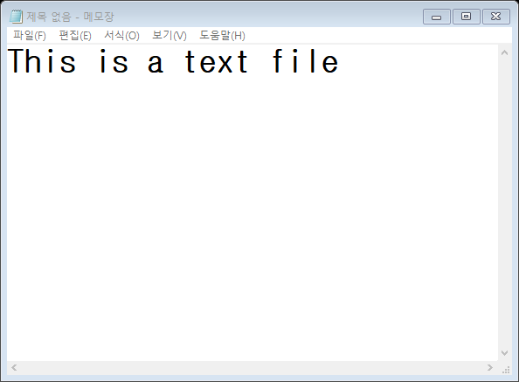
Text Files
❑ One of the basic and simple file types
Can be created and modified using Notepad (and also most of text editors)
Can be opened in Python
- using open() & read() function
- using numpy.loadtxt() function
- using pandas.read_table() function
file = open(‘file_name.txt’, ‘w’)
file = numpy.loadtxt(‘file_name.txt’)
file = pandas.read_table(‘file_name.txt’, sep = None)
src: https://upload.wikimedia.org/wikipedia/commons/thumb/2/23/Text-txt.svg/822px-Text-txt.svg.png

Slide 4

CSV / TSV Files
❑ One of the most common file formats to save structured data
Values in each line are delimited by commas (,) in CSV files and by tabs (\t) in TSV files
Can be opened in Python
- using open() & read() function
- using numpy.loadtxt() function
- using pandas.read_csv() function
file = open(‘file_name.csv’, ‘w’)
file = numpy.loadtxt(‘file_name.csv’, delimiter = ‘,’)
file = pandas.read_csv(‘file_name.csv’, sep = ‘,’)
file = open(‘file_name.csv’, ‘w’)
file = numpy.loadtxt(‘file_name.csv’, delimiter = ‘\t’)
file = pandas.read_csv(‘file_name.csv’, sep = ‘\t’)
src: https://maxcdn.icons8.com/office/PNG/512/Files/csv-512.png

Slide 5

Excel Files
❑ File format for Microsoft Excel, most popular spreadsheet software in the world
Arrangements are similar to those of CSV files, but each value is stored in a “cell”, which is separated by grid
Can be opened in Python
- using pandas.read_excel() function
file = pandas.read_excel(‘file_name.xlsx’, sheet_name = None)
src: https://encrypted-tbn0.gstatic.com/images?q=tbn:ANd9GcRRgOTRA7owbYC2zqEA-LLYCeca1Y368LEIOX7bUjnAqBVyUUzm

Slide 6

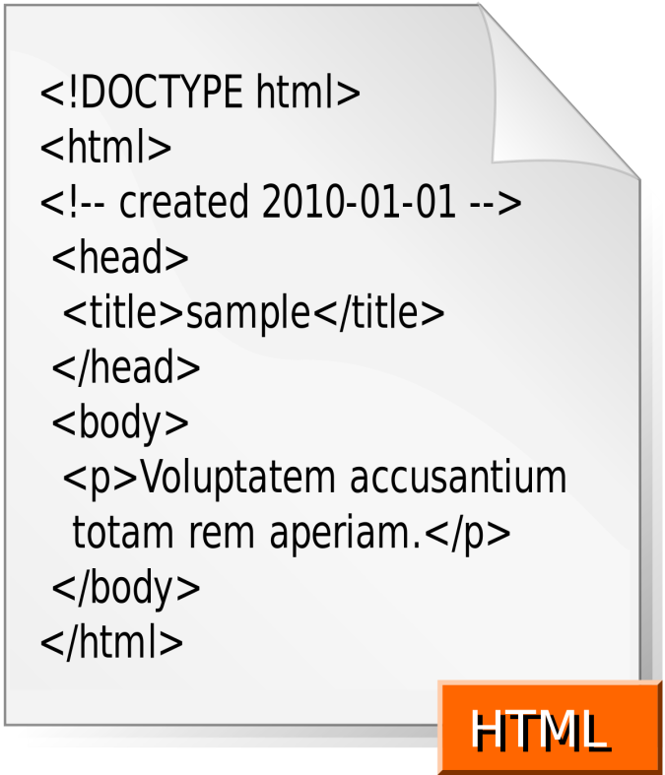
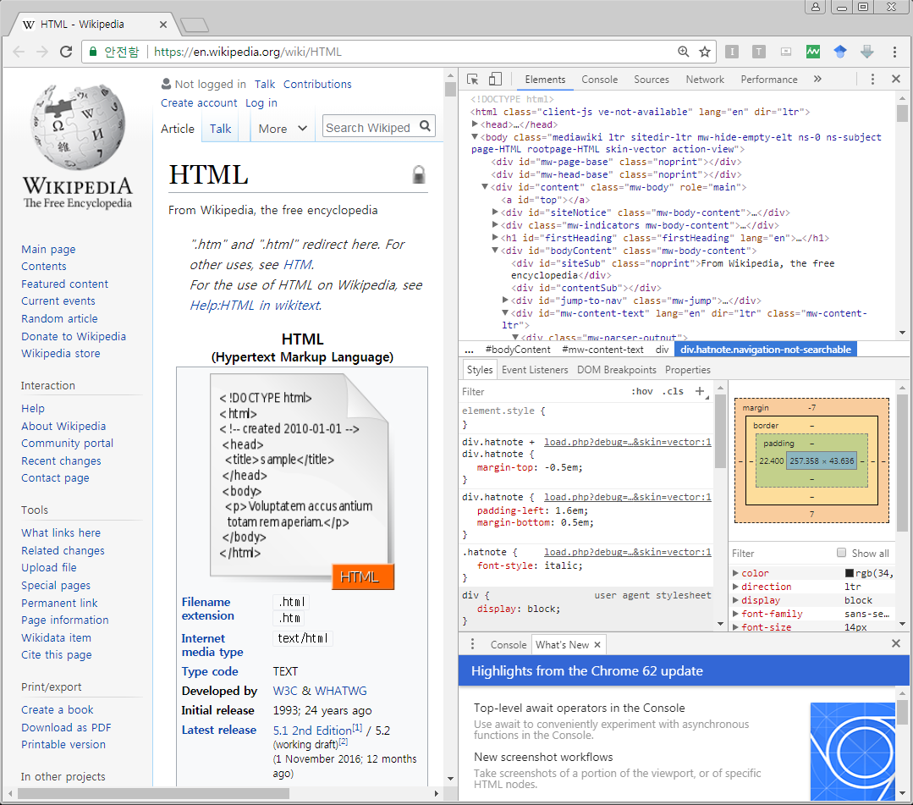
HTML
❑ HTML is the standard markup language for creating web pages and applications (HyperText Markup Language)
Files created with HTML has filename extension of .html
HTML elements are delineated by tags, written using angle brackets (< >)
∙ Often used in conjunction with CSS (Cascading Style Sheets)
src: https://en.wikipedia.org/wiki/HTML#/media/File:HTML.svg
https://upload.wikimedia.org/wikipedia/commons/thumb/6/61/HTML5_logo_and_wordmark.svg/200px-HTML5_logo_and_wordmark.svg.png

Slide 7
HTML
❑ HTML is the standard markup language for creating web pages and applications
Data from the web are retrieved and parsed using urllib & Beautifulsoup libraries in Python
from bs4 import BeautifulSoup
from urllib.request import urlopen
html = urlopen(url)
html_parsed = BeautifulSoup(html, 'html.parser')
src:

Slide 8

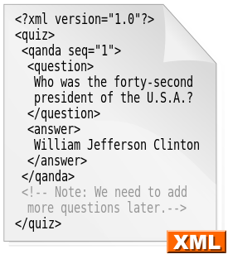
XML
❑ XML is a markup language that defines a set of rules for encoding documents in a format that is both human-readable and machine-readable (eXtensible Markup Language)
XML files can be parsed using xml library in Python
import xml.etree.ElementTree as ET
tree = ET.parse(‘file_name.xml’)
src: https://upload.wikimedia.org/wikipedia/commons/thumb/6/68/XML.svg/275px-XML.svg.png,
https://blogredalyc.files.wordpress.com/2016/07/unknown.jpg?w=225

Slide 9

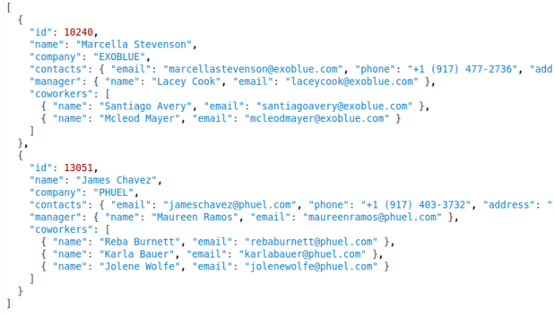
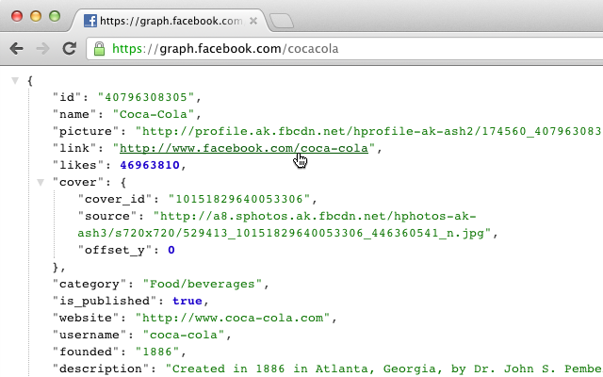
JSON
❑ JSON is an open-standard file format that uses human-readable text to transmit data objects consisting of attribute-value pairs and array data types
It was derived from JavaScript language, but language-independent nowadays
src: https://upload.wikimedia.org/wikipedia/commons/thumb/c/c9/JSON_vector_logo.svg/160px-JSON_vector_logo.svg.png
https://lh3.googleusercontent.com/68vofGty-EmFi1WHH-y0IbwRXeJpKTg3eTZOjZQoZAhJ6vuY7cL0G6yJ0CsE5sooUtJkSbqwUbI=w640-h400-e365
https://media.licdn.com/mpr/mpr/AAEAAQAAAAAAAAXXAAAAJDIwYmFhMzlhLWY4MGMtNDgwOC04OGJjLTE3ZTc4NDM5ODFjOQ.png

Slide 10

JSON
❑ JSON is an open-standard file format that uses human-readable text to transmit data objects consisting of attribute-value pairs and array data types
JSON files can be opened using json library in Python
import json
json_parsed = json.loads(json_data)
src: https://upload.wikimedia.org/wikipedia/commons/thumb/c/c9/JSON_vector_logo.svg/160px-JSON_vector_logo.svg.png
https://image.flaticon.com/icons/png/512/136/136525.png

